Slide 1
SOCIAL MOOD ON ECONOMY IDEX
Abdullah Alqahtani | 439051203

Slide 2

Outline
Introduction
Pipeline processing
Data collection : stream & scraping
AI filtering model
Sentiment classification model
Sentiment space
Visualization
Future work

Slide 3
Objective
Collecting data containing Saudi tweets with locations.
Building a deep learning model to extract economy tweets only
Building a deep leaning sentiment analysis model to classify data
Measuring Saudi citizens and residents satisfaction about the economy
Plotting social moods on the economy index

Slide 4
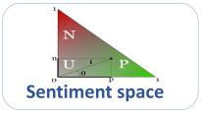
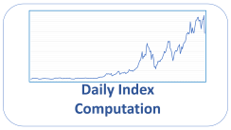
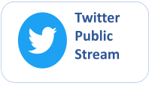

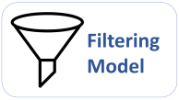
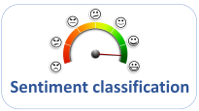

Pipeline constructing
API Streaming Or
scraping
Future Work
Deep learning model
Outlier Detection
and Imputation
Positive, negative and neutral

Slide 5

Twitter
Public
Stream

Slide 6

Data Collection: Streaming/scraping
Connecting to Twitter through Twitter API and filtering by Saudi Arabia cities coordinates like follow sample….
6

Slide 7

Filtering Model

Slide 8

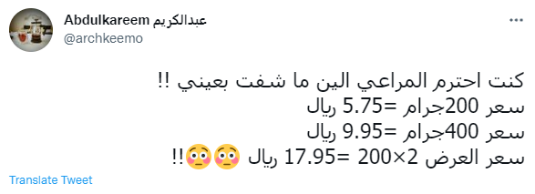
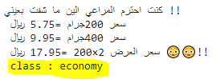
Filtering model
The most accurate deep learning model until now is The Arab-BERT model so we use it to classify data into 5 category [sport , religion , politic , economy]
Than we going to take economy tweet only
Note : the accuracy of this model is good but we have to increase it by fine tuning the model with our data
input
output
Bert classification model
8

Slide 9
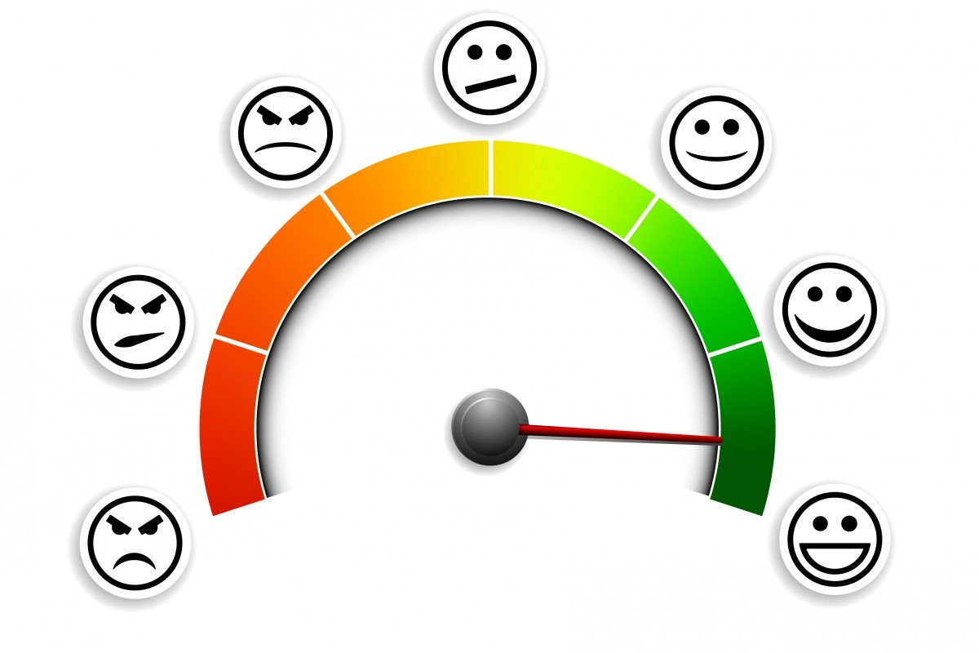
Sentiment classification

Slide 10
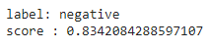
Sentiment classification
In sentiment classification we use The Bert-Base-Arabic model as one of the best models in classification for 3 labels [negative, neutral , positive]
input
output
Sentiment classification

Slide 11
Some sample of Sentiment classification
input
output
'label': 'negative’
'score': 0.6068520545959473
فهد زعلان من سعر كوب القهوة في ستار بوكس
عروض الجمعة الصفراء في متجر نون لا تفوتك
'label': 'neutral’
'score': 0.8241519927978516
Sentiment classification
الاقتصاد السعودي اقتصاد قوي ومتين و الدليل جائحة كرونا قارنا بالدول الاخرى وتعرف وش اقصد
'label': 'positive’
'score': 0.8995946049690247
انخفاض ارباح سهم شركة اسمنت القصيم بنسبة 20 بالمئة الله يعين حطيت فيها كل راس مالي
'label': 'negative’
'score': 0.9897794127464294

Slide 12

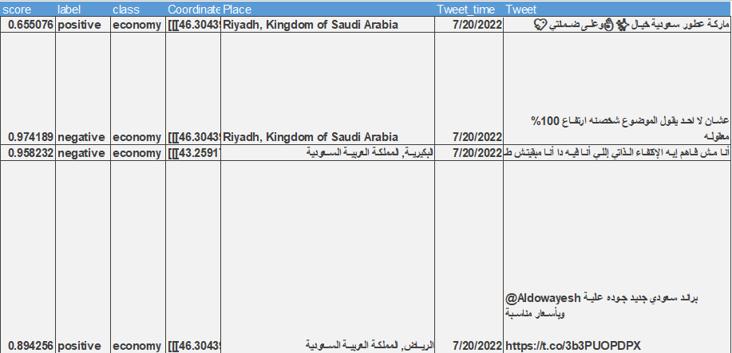
Data after double prediction
Bert Filter classification
Sentiment classification

Slide 13
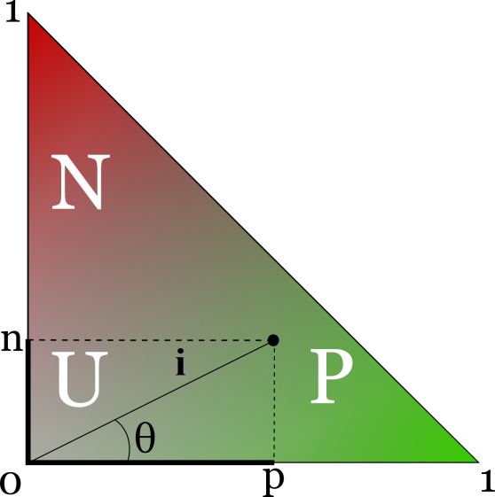
Sentiment space

Slide 14

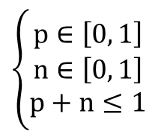
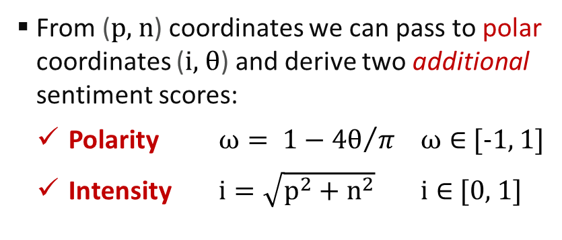
Sentiment space
To calculate the daily index we use the ISTAT formula called “Sentiment space”
In Sentix, positive (p) and negative (n) sentiment
scores of lemmas are constrained as follows:
Therefore Sentix maps lemmas to points
belonging to the sentiment triangle:
$$\left\{\begin{matrix}p∈\left[0, 1\right] \\ n∈\left[0, 1\right] \\ p+n≤1\end{matrix}\right.$$
From (p, n) coordinates we can pass to polar coordinates (i, θ) and derive two additional sentiment scores:
Polarity $ω= 1−{4θ}/π$ $ω∈$ [-1, 1]
Intensity $i=\sqrt{p^{2}+n^{2}}$ $i∈$ [0, 1]
This way Sentix lemmas are
mapped to a 4D sentiment space
How do we use sentiment space valuables
to calculate the index?
14

Slide 15
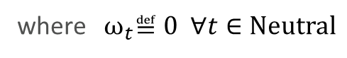
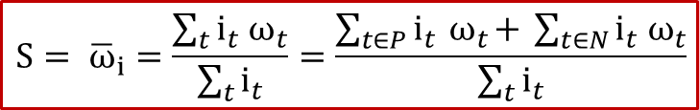
Clustering and Calculation of the Index
How do we use sentiment space valuables
to calculate the index?
Once sentiment scores (p, n, ω, i) are available for all the tweets of a daily block…
Lastly we compute the daily index value (S), which depends on the distribution of tweets within the Positive, Neutral and Negative classes
$$S= {\overline{ω}}_{i}=\frac{\sum_{t}{i_{t}{ ω}_{t}}}{\sum_{t}{i_{t}}}=\frac{\sum_{t∈P}{i_{t}{ ω}_{t}+ }\sum_{t∈N}{i_{t}{ ω}_{t}}}{\sum_{t}{i_{t}}}$$
where ${ ω}_{t}≝0 ∀t∈Neutral$
15

Slide 16
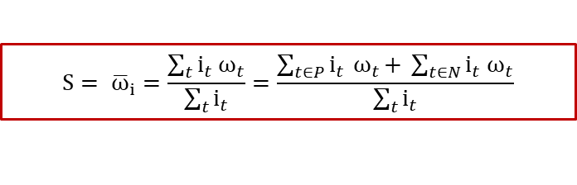
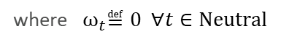
Data after apply formula
$$S= {\overline{ω}}_{i}=\frac{\sum_{t}{i_{t}{ ω}_{t}}}{\sum_{t}{i_{t}}}=\frac{\sum_{t∈P}{i_{t}{ ω}_{t}+ }\sum_{t∈N}{i_{t}{ ω}_{t}}}{\sum_{t}{i_{t}}}$$
where ${ ω}_{t}≝0 ∀t∈Neutral$
16

Slide 17
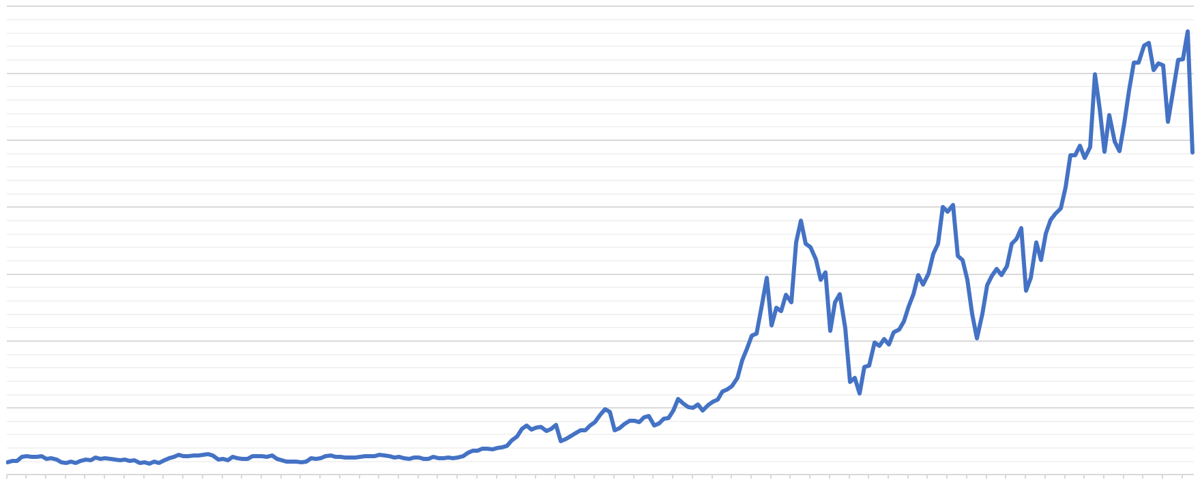
Daily Index
Computation

Slide 18
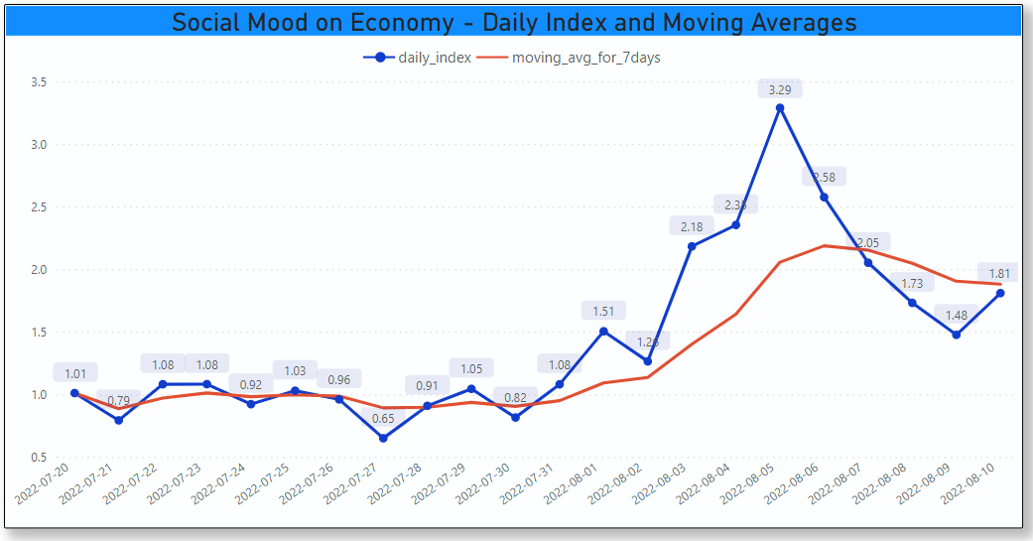
Visualisation
There is a plot of 22 days of data collection
18

Slide 19
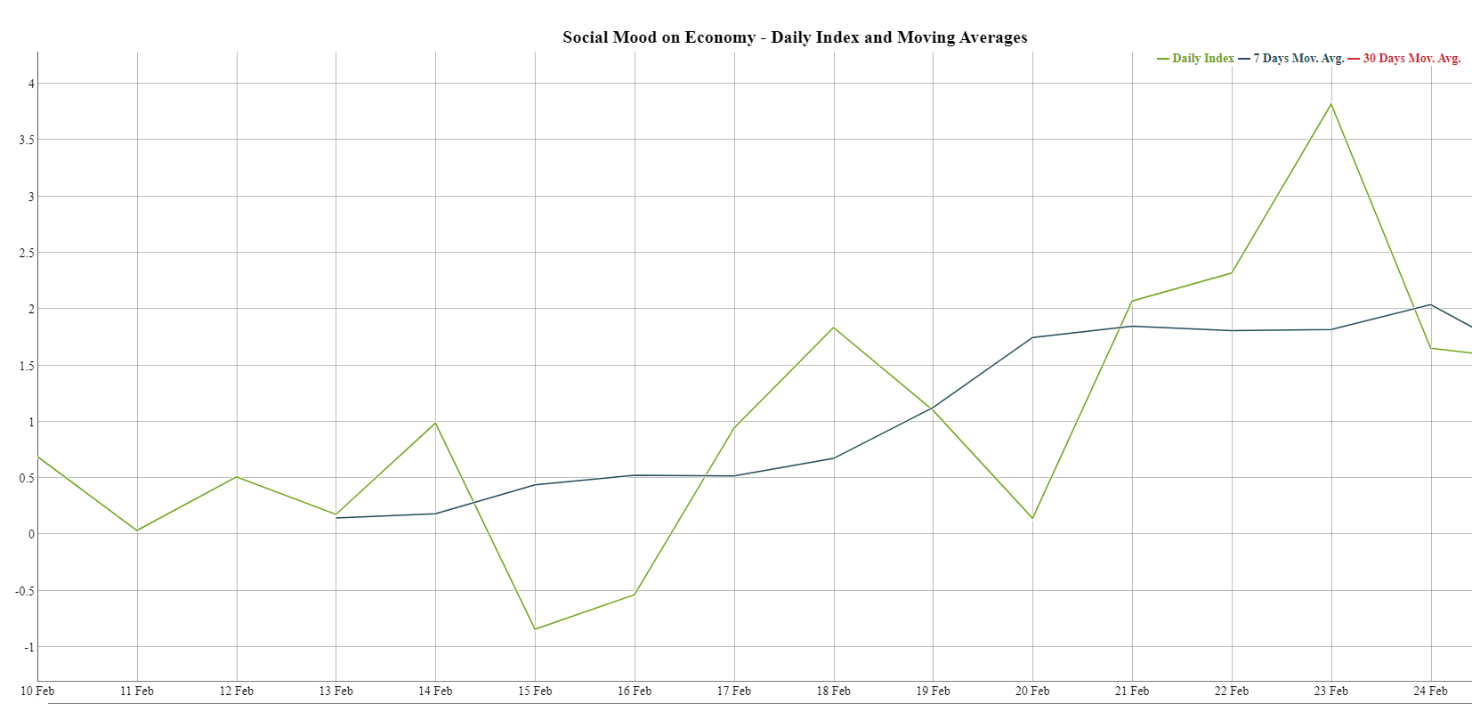
Visualisation of ISTAT
There is a plot of 22 days of data collection
19

Slide 20
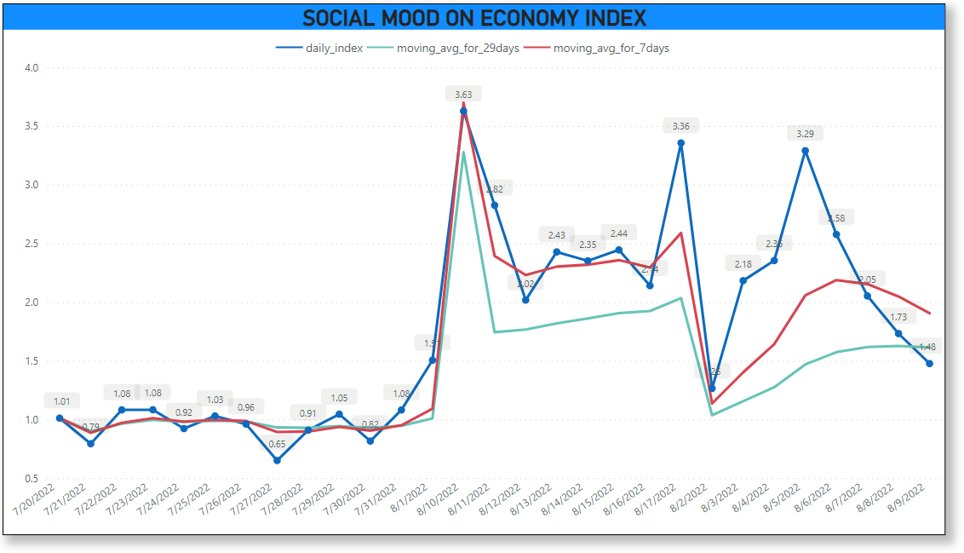
Visualisation
There is a plot of 29 days of data collection
20

Slide 21

Surveillance System

Slide 22
Surveillance System
The system will be monitored from time to time in the event of a sudden and strong rise in the indicator or a sudden and strong decrease in the indicator
And that will be considered as
Future Work
22

